Slide 1
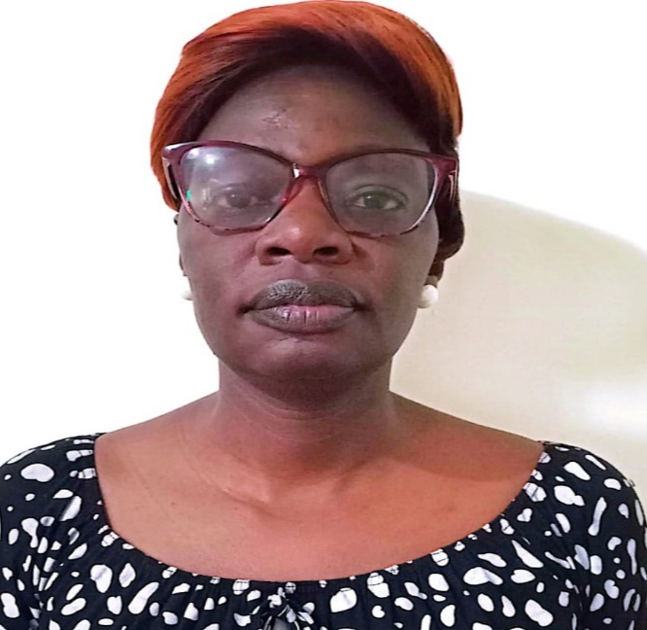

PREVALENCE OF ADVANCED HIV DISEASE ( AHD) AMONG PEOPLE LIVING WITH HIV (PLHIV) ATTENDING UMOJA HEALTH CENTRE, NAIROBI, KENYA.
ANGELINE NGANO
UMOJA HEALTH CENTRE.

Slide 2
Authors and Affiliations
Authors
A.Ngano1, S.Mongare1, G.Wairimu1, M.Abdullahi1, D.Odock2, C.Ngunu3,
R.Riang’a3
AFFILIATIONS:
    Umoja Health Centre, Nairobi County.
    Embakasi West sub county, Nairobi County.
    SHINE Project, Nairobi City County.
    Nairobi City County.

Slide 3
Introduction
Advanced HIV Disease (AHD) is a severe form of HIV infection where the immune system is significantly weakened leading to opportunistic infections and death. It is defined as a CD4 cell count of <200 cells.
According to The NASCOP guideline 2022,a CD4 test is indicated in new naive ART patients, Treatment interrupters of more than 90 days, and suspected treatment failure(viral load of >200 copies)
A substantial number of people continue to develop AHD and it is reported by UNAIDS that by the end of 2018 around 570000-1.1 million died due to AHD and therefore it's important to screen the suspects to reduce morbidity and mortality.
This study aimed to determine the prevalence of AHD among PLHIV attending Umoja Health Centre.

Slide 4
Methodology
A retrospective study was conducted among 155 PLHIV who were ART naïve, treatment interrupters (>90 days) and suspected treatment failure attending Umoja Health Center between January 2024 and March 2025.
Data extracted from Kenya EMR system included sex, ART naïve and CD4 test results . A return to care register was reviewed to identify treatment interrupters while the viremia register was used to capture suspected treatment failures.
Data collected was analyzed through Microsoft excel.

Slide 6
Summary of CD4 count and HIV stage classification
Total- 155

Slide 7
Analysis of the classified PLHIV

Slide 8
Analysis of PLHIV with AHD n (40)
50%
27.5%

Slide 9
AHD according to sex n (40)

Slide 10
CONCLUSION
Overall the prevalence of AHD was 49% with naïve patients contributing 50%. In terms of sex, male were more prevalent at 58% compared to female at 42%.
Therefore comprehensive package of care as recommended by WHO is crucial in management and prevention of morbidity and mortality.

Slide 11
My Co-authors
Umoja H/C
Embakasi West Sub- county
SHINE project Nairobi City County
IPNET Kenya
Acknowledgement
THANK YOU

